Slide 1
10 classes: 1 safe, 9 distractions
Distracted Driver Detection
Can simple models on raw pixels recognise what a driver is doing, even for drivers they have never seen?
UE24CS352A Machine Learning | Mini-Project | Problem #24
Arya Devang (PES1UG24AM054) | Ananthakrishna (PES1UG24AM036)
github.com/Arya-677/ML_miniProject_sem5
Notes:
Introduce the team and the problem in one sentence: given one in-cabin image, predict the driver's activity (10 classes). We re-implemented the CS229 report by Feng & Yue and extended it with a stricter test: unseen drivers. Roadmap: problem and data, pre-processing, the five models, training and verification, results, best-model analysis, conclusions and demo.

Slide 2
One image in, one of 10 activities out
Task
Given a single in-cabin camera frame, classify the driver's activity.
Why it matters
Distracted driving contributes to serious crashes, and different activities carry different risk.
Basis
Re-implementation of the CS229 report (Feng & Yue, 2019): five classifiers on raw pixels.
c0 Safe driving
c1 Texting - right
c2 Phone - right
c3 Texting - left
c4 Phone - left
c5 Operating radio
c6 Drinking
c7 Reaching behind
c8 Hair and makeup
c9 Talk to passenger
Our question: how well do simple models work on raw pixels, and does that accuracy hold for drivers the model has never seen?
Notes:
Explain the 10 classes (c0 safe driving, c1-c9 distractions). Stress the two parts of our question: (1) compare five models, (2) test whether accuracy survives on new drivers. The second part is what we added on top of the reference paper.

Slide 3
State Farm data, and two ways to split it
22,424
10
26
640x480
labelled images
classes
drivers
RGB frames
A Random 80/20 split
B Driver-wise 80/20 split
Same protocol as the reference report
17,940 train / 4,484 val
All 26 drivers appear on both sides
Almost-identical frames of one driver on both sides: may be optimistic
Whole drivers held out for validation
17,747 train / 4,677 val
21 train drivers, 5 val drivers, 0 overlap
Measures real-world generalisation to new people
Why two? Images are video frames, so one driver's frames look almost identical. The official test set is unlabelled, so we hold out 20% of the labelled data.
Notes:
Key idea of the whole project: the dataset has 26 drivers and each contributes thousands of near-identical frames. A random split puts the same person in train and validation, so a model can memorise people. The driver-wise split fixes that: 21 drivers train, 5 drivers validate, zero overlap. We report both so the results can be compared with the reference paper (random) and also show the honest number (driver-wise).

Slide 4
Pre-processing: shrink, flatten, centre
Image
Resize
Flatten
Normalise
Classifier
Full photo
>
Shrink it
>
One list
>
Centre colours
>
5 models
large colour image
64x64 pixels
pixels in a row
subtract average image
pick 1 of 10 activities
75x smaller
Fair test
Fast re-runs
each image becomes 75 times smaller, so models train in minutes instead of hours
the average image comes from training data only, so validation images never influence it
processed images are saved once, so later runs start instantly
Notes:
Walk left to right. Resizing to 64x64 is a trade-off: it makes from-scratch training feasible but loses fine detail (phone versus hand). Subtracting the training mean image centres the data, which helps gradient descent. The mean is computed on the training split only to avoid leakage.

Slide 5
Five models, five different ideas
Model | Built | The idea in plain words | What makes it different
Linear SVM | NumPy | Draws straight dividing lines between activities, leaving the widest gap | Learns mostly from hard, borderline images
Softmax | NumPy | Also straight lines, but scores each activity as a probability | Tells you how confident it is
Two-layer NN | NumPy | A small neural network with one hidden layer of 100 units | Can learn patterns that straight lines cannot
Naive Bayes | scikit-learn | Checks how well each pixel matches a typical image of each activity | Very fast, but treats pixels as unrelated
Decision Tree | scikit-learn | Asks a chain of yes/no questions about pixel brightness | Memorises the training images
Teal = written from scratch by us in NumPy. Amber = scikit-learn baselines.
Notes:
Go row by row, one sentence each. SVM and softmax both draw straight dividing lines; the SVM focuses on borderline examples, softmax gives probabilities. The neural net adds one hidden layer of 100 units so it can learn more complex patterns. Naive Bayes treats every pixel as independent, which is not true for images. The decision tree uses default settings, so it keeps asking questions until it fits every training image. (If asked: the SVM uses hinge loss, softmax and the net use cross-entropy loss, all with L2 regularisation.)

Slide 6
How we trained and checked the models
1
How it learns
2
Choosing settings
3
Checking our maths
Small batches: learns from a few hundred random images at a time
Repeated: 2,000 training steps
Same start: fixed random seed, so results repeat
Tries: about 9 to 12 combinations per model
Picks: the best on a held-out part of the training data
Never uses the validation images to choose
Method: compare our formulas with a slow, simple numerical check
Result: they match almost exactly
Meaning: our from-scratch code is correct
Learning speed
How big a correction the model makes after each batch. Too small is slow; too big overshoots.
Regularisation
A penalty that keeps the model simple, so it does not just memorise the training images.
Notes:
Three points. (1) Learning: the models learn from small random batches of images for 2,000 steps, with a fixed seed so results repeat (technically mini-batch SGD). (2) Choosing settings: we tried several combinations of learning speed and regularisation and picked the best on a part of the training data, so the validation set is only used for the final number. (3) Checking: we compared our hand-written gradients with a slow numerical check; they agree to about 1e-10, so the from-scratch maths is correct. Exact chosen values are in results.json.

Slide 7
Accuracy collapses on unseen drivers
NN
best model under both protocols (98.0% / 51.6%)
Reference paper (random split): NN 92, softmax 82, SVM 71, tree 85, NB 55. Our SVM scores higher because we tuned it carefully.
Notes:
Read the chart in two steps. Teal bars (random split): ranking is NN 98.0, SVM 95.3, tree 89.1, softmax 71.4, Naive Bayes 55.2, which beats or matches the reference paper. Amber bars (driver-wise split): every model falls, from 98 to 52 for the best one. The neural network is still best, but the decision tree falls the furthest, from 89 to 30. Our SVM is much higher than the paper's 71.4 because we tuned the learning rate and regularisation by grid search and fixed the initialisation. Why the drop? Frames from one driver are near-identical, so on the random split models can memorise people (the tree scores 100% on training but 29.7% on new drivers; the network 99.1% vs 51.6%). Caveat: only 5 validation drivers and one seed, so exact numbers are noisy.

Slide 8
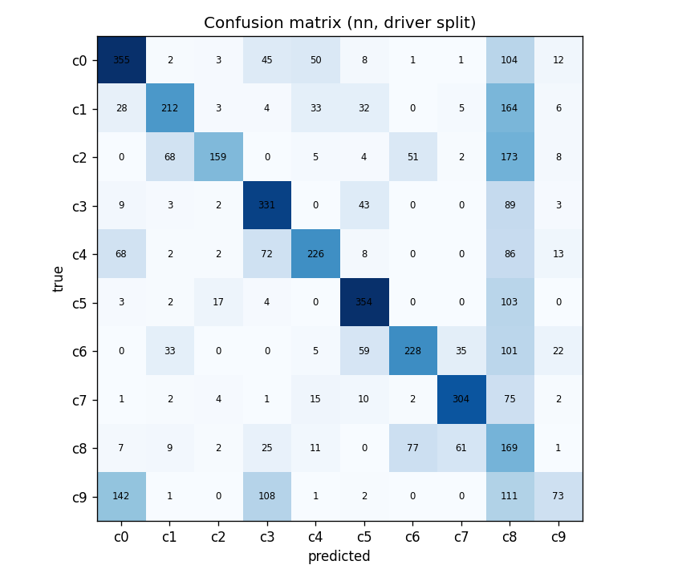
Best model: where the neural net fails
Hair and makeup is a catch-all: 1 in 4 predictions is this class, though only about 1 in 13 images really is. Most common mistake: phone-right labelled as hair and makeup.
Notes:
Confusion matrix on the driver-wise split for the best model. Strong diagonal for reaching behind, operating the radio and texting-left. The weak spot is the c8 column: the network pushes uncertain right-hand-near-face images into 'hair and makeup'. Phone-right, texting-right, drinking and hair/makeup all share the same pose (right hand near the face) and at 64x64 the object in the hand is only a few pixels. Talk-to-passenger is worst at 16.7% because it has no distinctive object, only head orientation.

Slide 9
Conclusions, limits and demo
What we found
Limitations, next steps
Two-layer NN wins both protocols: 98.0% random, 51.6% driver-wise
Random-split scores are optimistic: about 42 points lower on unseen drivers
Our from-scratch maths was checked and is correct; settings were never tuned on validation
Small 64x64 images lose detail; these models ignore where things are in the picture
Tested with one random seed and only 5 unseen drivers
Next: a CNN (image-specific neural network), more varied training images, testing on more drivers
Live demo
1 Open the notebook, last section
2 Set IMAGE_PATH (or leave None for a random image)
3 Run: image, predicted activity and top-3 probabilities
Notes:
Close with the three findings, then the honest limitations. Then do the live demo: open distracted_driver_detection.ipynb, scroll to section 8, run the cell. It loads results_driver/model_nn.npz plus the saved mean image, shows the image, prints the prediction and top-3 probabilities. Have one image from a class the model handles well (e.g. reaching behind, operating the radio) ready as backup, and be ready to explain a wrong prediction using the confusion matrix. Repo: github.com/Arya-677/ML_miniProject_sem5.

